Slide 1
INFO 3135
Recursion
Merge and Quick sort

Slide 2
Recursion
We are familiar with repetition in the form of loops, for(), while().
Another way to achieve repetition is through recursion, which occurs when a function refers to itself in its own definition
Functions can call other functions obviously, so it should come as no surprise that C++ allows a function to call itself
To understand recursion in function calls we need to understand what happens when a C++ function is called.

Slide 3
Function calling
Parameters are initialized and values are set
Where to resume execution once this function has completed – where was this function called from
Other information the system needs to properly execute the function also needs to be stored somewhere.
Dynamic allocation using the runtime stack is used for this purpose
Each function call gets pushed to the stack with its information
Each function is identified uniquely on the stack which allows the distinction between variables with the same name.
This is important for recursive functions especially

Slide 4
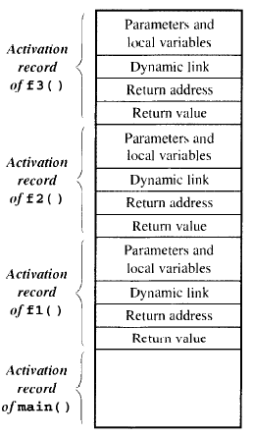
Function Calling
The state of each function is characterized by its variables, parameter values and return address.
The data area that contains this information is called the “Activation Record” or “Stack Frame”
An activation record exists for as long as a the function owning it is executing
Only the activation record of main() outlives every other activation record.
The diagram shows main() calls f1() which calls f2() which calls f3()
When f3() completes, its activation record is popped off the stack and f2() resumes.

Slide 5
Recursive Functions
Recursion is calling a function that has the same method signature as the caller.
Therefore a recursive function call is not really a function calling itself but an instantiation of a function calling another instantiation of the method definition.
Each call to the function will have its own activation record
Lets look at an example using the function: double power( int x, unsigned int n );
This function will raise any number x to the non-negative power of n

Slide 6
Recursive Power
double power( int x, unsigned int n ){
if( n == 0 )
return 1.0;
else
return x * power( x, --n);
}
Let try this in Visual Studio

Slide 7
The logic of power
The power function will continue to recursively call until the n-1 causes the if( n== 0 ) return 1.0 to execute
The last recursive call is called the anchor (the last step in a chain of recursive calls)
The anchor ensures we don’t fall into an infinite loop
The anchor produces 1 as a result of raising x to the power of 0
The result is passed back to the previous call which returns x * 1
The third call result is passed back to the previous call which returns x * x
Etc...etc.…

Slide 8
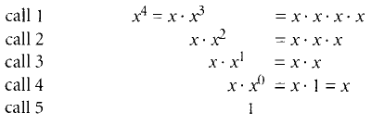
Heres what power looks like
As we see each call waits for the next call to return prior to multiplying x with the return value
As each function returns the return value increases
When the final invocation returns the value of x⁴ has been calculated

Slide 9
Non-recursive version of power
double nonRecPower( int x, unsigned int n ){
double result = 1;
for ( result = x; n > 1; --n ){
result *= x;
}
return result;
}

Slide 10
Benefits
Is recursion better?
Our example is small and the non-recursive version is no much larger that the recursive
In general recursive functions are:
Smaller – less code
Can be more intuitive
Improved readability
Improved self documentation
Can simplify coding

Slide 11
Finally – 3 types of recursion
Linear, Binary, Multiple
Linear – makes at most one recursive call each time it is invoked
Useful when viewing algorithmic problems in terms of a first and last element or when working with a remaining set that has the same structure as the original set
Binary – when an algorithm makes two recursive calls.
Useful for example, when we need to solve two similar halves of some problem
Multiple – use multiple recursion when a function
May make multiple recursive calls, with that number potentially being more than two.

Slide 12
Merge Sort
Merge-sort is based on the divide-and-conquer approach
Divide-and-conquer consists of the following three steps:
1. Divide: If the input size is smaller than a certain threshold (say, one or two elements), solve the problem directly using a straightforward method and return the solution obtained. Otherwise, divide the input data into two or more subsets.
2. Recur: Recursively solve the sub-problems associated with the subsets.
3. Conquer: Take the solutions to the sub-problems and “merge” them into a solution to the original problem.

Slide 13
Merge Sort
To sort a sequence S with n elements using the three divide-and conquer steps, the merge-sort algorithm proceeds as follows:
1. Divide: If S has zero or one element, return S immediately; it is already sorted. Otherwise (S has at least two elements), remove all the elements from S and put them into two sequences, S1 and S2, each containing about half of the elements of S; that is, S1 contains the first ⌈n/2⌉ elements of S, and S2 contains the remaining ⌊n/2⌋ elements.
2. Recur: Recursively sort sequences S1 and S2.
3. Conquer: Put back the elements into S by merging the sorted sequences S1 and S2 into a sorted sequence.

Slide 14
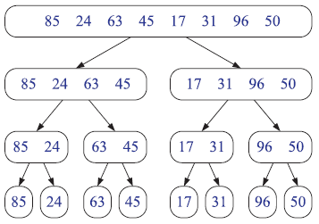
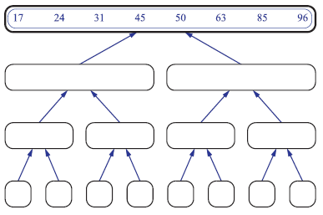
Merge sort
The merge sort will recursively divide the sequence until it reaches the smallest size and then sort.

Slide 15
Merging
Merging of two lists done as follows:
The first element of both lists is compared.
If sorting in ascending order, the smaller element among two becomes a new element of the sorted list.
This procedure is repeated until both the smaller sub-sequences are empty and the newly combined sub-sequence covers all the elements of both the sub-sequences.

Slide 16
PsuedoCode
From VisualGo
split each element into partitions of size 1
recursively merge adjacent partitions
for i = leftPartIdx to rightPartIdx
if leftPartHeadValue <= rightPartHeadValue
copy leftPartHeadValue
else: copy rightPartHeadValue
copy elements back to original array

Slide 17
Quick Sort
This sort algorithm is also based on the divide-and-conquer
The quick-sort algorithm sorts a sequence S using a simple recursive approach.
We divide S into sub-sequences, recur to sort each sub-sequence, and then combine the sorted sub-sequences by a simple concatenation

Slide 18
Quick Sort
1. Divide: If S has at least two elements (nothing needs to be done if S has zero or one element), select a specific element x from S, which is called the pivot. Common practice is, choose the pivot x to be the last element in S.
Remove all the elements from S and put them into three sequences:
• L, storing the elements in S less than x
• E, storing the elements in S equal to x
• G, storing the elements in S greater than x.
Of course, if the elements of S are all distinct, then E holds just one element— the pivot itself.
2. Recur: Recursively sort sequences L and G.
3. Conquer: Put back the elements into S in order by first inserting the elements of L, then those of E, and finally those of G.

Slide 19
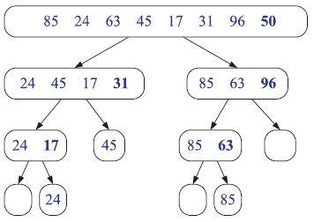
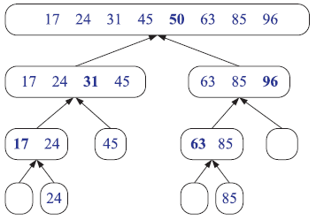
Quick Sort
Split the sequence at the pivot, repeat then sort then concatenate.

Slide 20
PsuedoCode
From visualGo
for each (unsorted) partition
set first element as pivot
storeIndex = pivotIndex + 1
for i = pivotIndex + 1 to rightmostIndex
if element[i] < element[pivot]
swap(i, storeIndex); storeIndex++
swap(pivot, storeIndex - 1)

